Slide 1
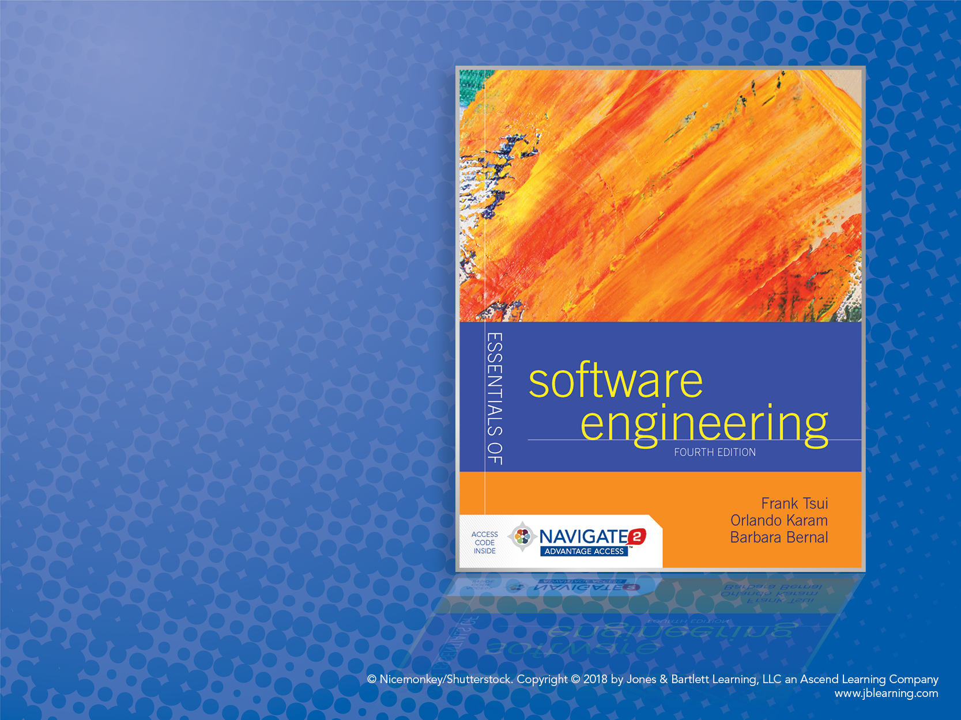
Chapter 11: Configuration Management, Integration, and Builds

Slide 2
Configuration Management
What does configuration management really manage?
Software artifacts
Change control activities
System build activities

Slide 3
Software Configuration Management
The management of all the artifacts produced as a part of the software development and software support activities, for example:
Requirements specifications
Design documentation
Source code
Test scenarios
Executable code
Data base tables
Initialization data
Customer problem calls
Problem fixes
User documentation

Slide 4
Managing the Software Artifacts
Interested in:
Inter-relating the artifacts, for example:
By “usage” relationship
By packaging into a “release” relationship
By promoting into different test bucket level
Intra-relating multi-versioning of each artifact
Access and protection of each artifact

Slide 5
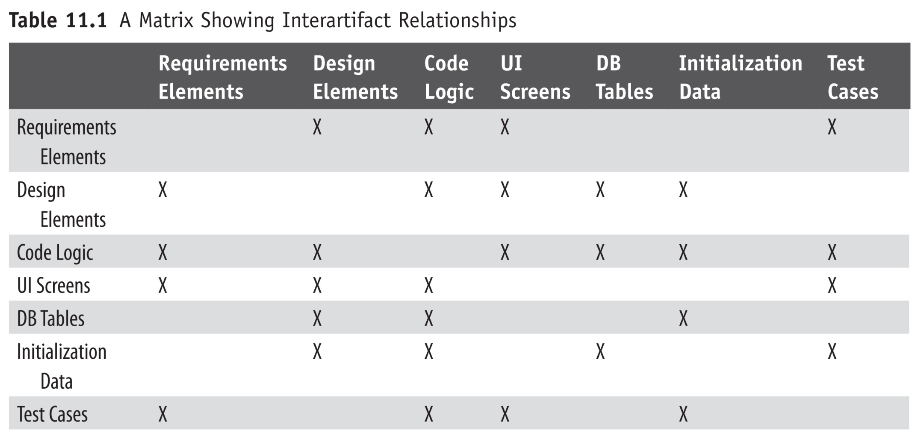
Example: Inter-Artifacts Relationship Matrix
The artifacts are not single dimensional in that they may be related to
each other, where the relationship may be such that one is an input to another or. . . one is used by another.

Slide 6
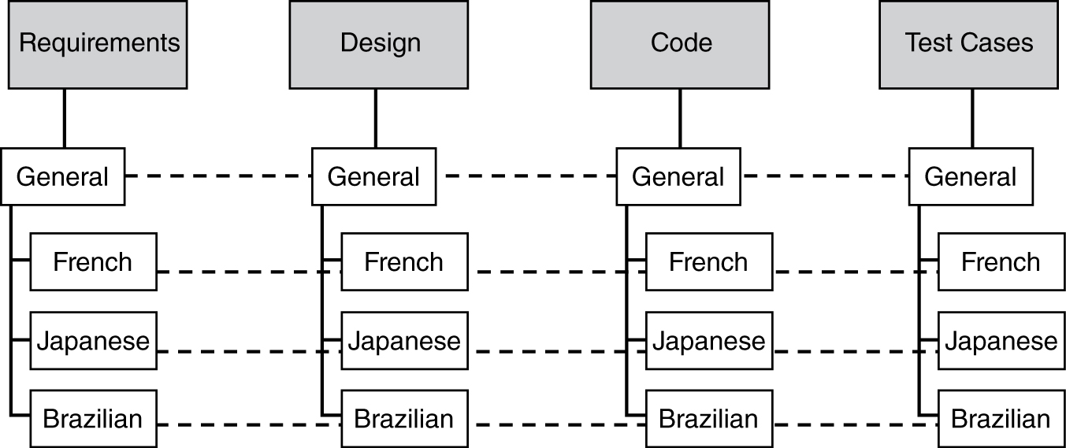
“Multi Relations”
Intra-entity relationship: e.g., where there are multiple country versions of requirements
Inter-entity relationship: e.g., where design is the input to code

Slide 7
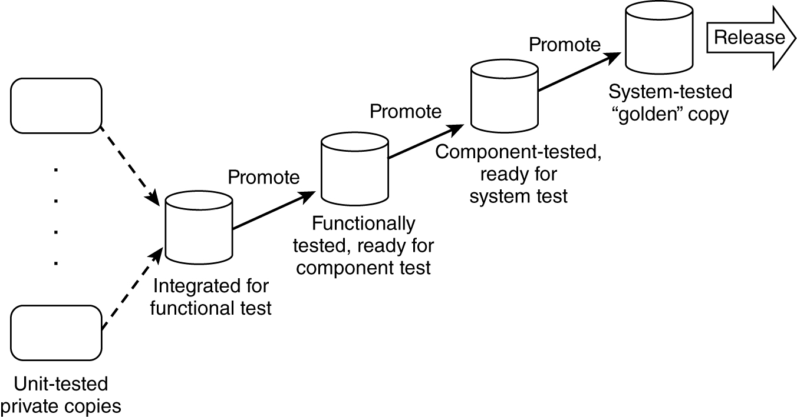
“Promotion” of Artifacts: An Example of Configuration Management Influenced by Testing Process
Another Intra-Entity Relation

Slide 8
Another Intra-Entity Relation: Code Changes and Versioning Example
Original
Module 1 – v0
Modified
Module 1 – v1
Modified 2nd time
Module 1 – v2
Modified 3rd time
Module 1 – v3

Slide 9
Some Aspects of Managing Software Artifacts Inter-Relationships
Link the versioning of code modules to design artifacts.
Further add the relationship of requirements to design and code artifacts.
Now relate the test scenarios to these.
Fold in the possibilities of multiple releases and the support of these multiple releases that can have fixes applied to them.
Finally, consider these in terms of the world-wide market where we may have Japanese version, German version, French version, Chinese version, Brazilian version, Indian version, etc.

Slide 10
Configuration Management – (Control)
In order to control all the pieces and parts of the software artifacts, we need two basic models:
Parts identification model
Parts storage and access model

Slide 11
Sample: Parts Identification Model
A software artifact must be uniquely identifiable with a “name” composed of:
PP: two position product code
CC: two position country code
RRR: three position release code
VVV: three position version code
TT: two position artifact type code
FF: two position format code
A sample artifact identifier: PP.CC.RRR.VVV.TT.FF
where “.” is used as the delimiter

Slide 12
Parts Storage and Access Model for Configuration Management
Parts Database
Parts
Control
System build
Individual
user
Individual
user
. . . .

Slide 13
Parts Storage and Access Model for Configuration Management (cont.)
Basic functions to:
Create a part.
Delete a part.
Access functions to:
View a part.
Modify a part.
Return a part.
Control and service functions:
Import part(s).
Export part(s).
List parts.
Set release or version numbers.
Increment release or version numbers.
Change part name, version, release, artifact type, etc.
Gather parts.
Merge into a part.
Promote parts.
Compare parts.
Lock/unlock parts.
Where used and cross-referencing the parts.

Slide 14
(System Build) with Configuration Manager
Construct a build (dependency) list.
Compile.
Link.
Generate the required executables that are ready to run.

Slide 15
Some Configuration Management Tools
Tier 1: Version control and change control
Revision control system (RCS)
Source code control system (SCCS)
Concurrent version system (CVS)
Tier 2: Builds
Make utility
Odin
Cons
Scons
Tier 3: Configuration management for large systems
PVCS: ChangeMan (Serena Software)
Rational Clear Case (IBM)
Visual SourceSafe (Microsoft)
Perforce (Perforce Software) − we just got this into SPSU (2011)

